Slide 1
Ion Chef & S5/S5xl System overview & workflow

Slide 2
Ion Chef Agenda
Ion ChefTM System overview:
Interactions with Ion ChefTM
Setting up Ion ChefTM
End-to-end process on Ion Chef™
Sample and reagents tracking on Ion ChefTM
S5 System Overview
Planning & Executing a Run

Slide 3
S5/S5 XL System Overview

Slide 4
Ion Chef Agenda
Ion ChefTM System overview:
Instrument
Deck and functional modules
Reagents and consumables
Interactions with the system
Setting up Ion ChefTM
End-to-end process on Ion Chef™
Sample and reagents tracking on Ion ChefTM

Slide 5
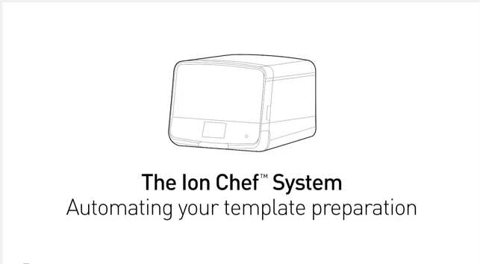
Ion Chef TM Video Overview
Notes:
Hit shift and click in presentation mode to view the video on YouTube
https://www.youtube.com/watch?v=qpsd93d2mcc

Slide 6
Workflow Overview

Slide 7

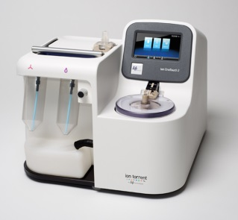
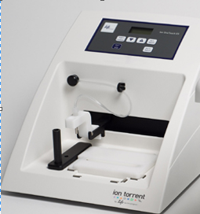

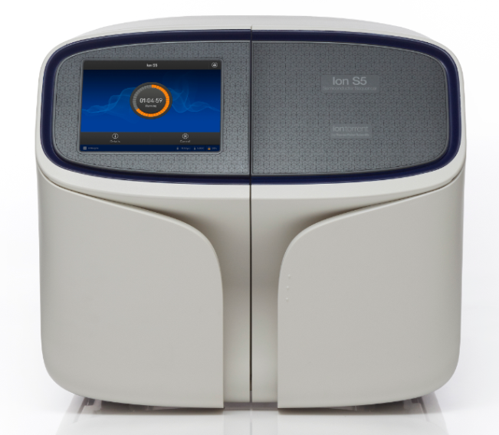
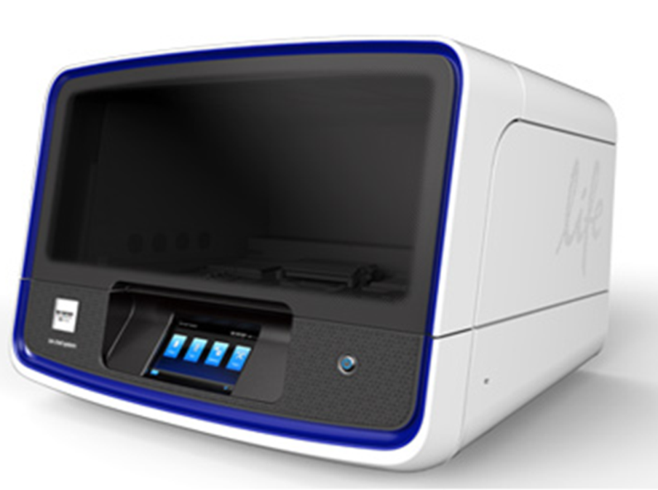
Ion Chef ^{TM:} Automating your template preparation
Library Prep
Template Prep
Enrichment
Loading
Ion Chef TM
Library Prep
Notes:
Simplifies the workflow, Minimizes sources of user-introduced variability, Saves time and labor, Supports sequencing preparation for the Ion PGM™ and Proton™ systems and chips

Slide 8


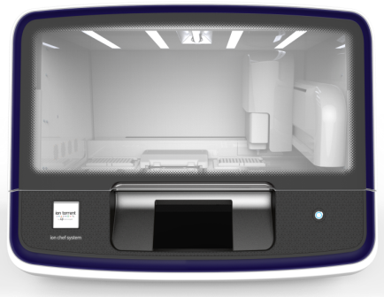


Customers Typically Run Ion Chef™ Overnight
Ion Chef run is 10.5 hours. However, customers typically take advantage of programming feature that enables the overnight run (i.e. 17h+)
Day 1
Day 2
Option 1
Option 2
Morning
Afternoon
Notes:
Overnight runs, chips ready in the morning. We are going to do option 1 in class

Slide 9

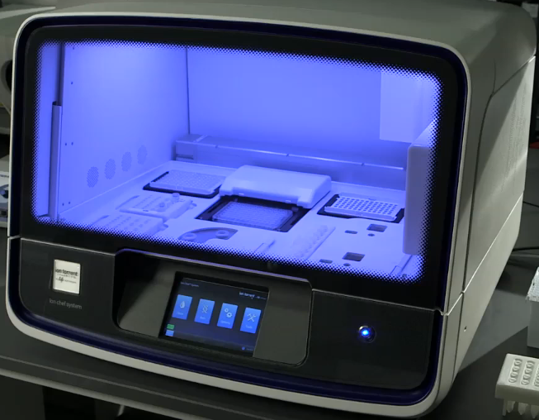
Ion Chef™ System Orientation
Automated Template Prep, Enrichment and Loading

Slide 10
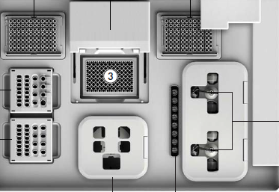
Ion Chef™ System Orientation: Deck Layout
Thermal cycler lid
Used tip rack.
Thermal cycler
Enrichment module
New tip rack
Reagent Cartridge Cold Station
Tube centrifuges for ISP recovery and washing
Solution Cartridge Ambient Station
Chip centrifuge

Slide 11
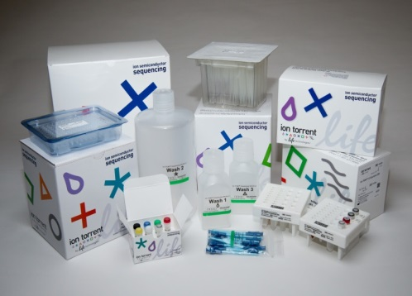
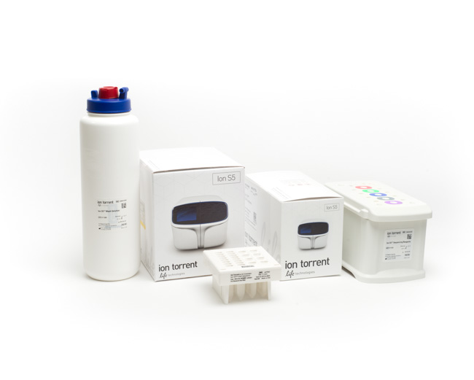
Ion Chef™ Kit Configuration
Ion PGM™ HiQ™ Chef Kit
Ion 540™ Kit – Chef
Ion 520™/530™ Kit - Chef
(8 reactions)
Template Prep &
Chip Loading on
Ion Chef™ system
Sequencing
on Ion PGM™ system and Ion S5/XL system
2 samples/run per cartridge set
Supports 200 and 400 bp RNA and DNA applications
Compatible with TSS 5.0 or higher
Notes:
The new IC 200 kit includes template prep and sequencing kit or ease of ordering. 4 runs, 8 reactions.

Slide 12
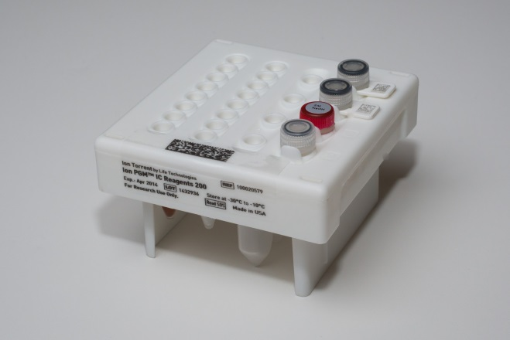
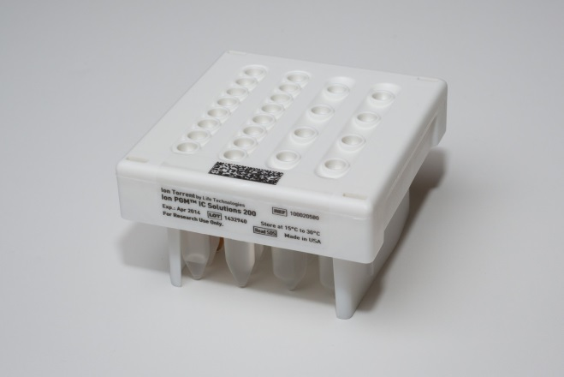
Ion Chef™ Reagent Cartridges Composition
4º C Reagent Cartridge
Reagent Mix
Enzyme Mix
Primer B
ISP
Test Fragments
Seq Primer
Seq Polymerase
NaOH
Ambient Temp Reagent Cartridge
Annealing Buffer
Loading Buffer
Water
IPA
MyOnes
Tween Solution
Reagent B
Recovery Solution
Wash Solution
Emulsion oil
Notes:
Customer sample will be added to 4C cartridge

Slide 13
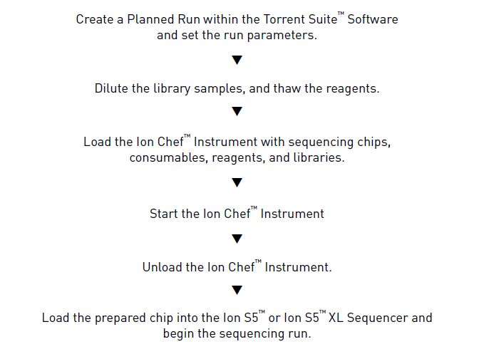
Chef Workflow

Slide 14
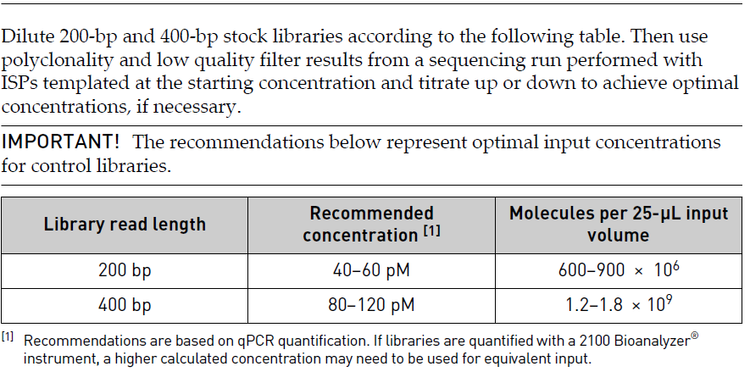
Diluting Libraries 520™/530™ Chips
Notes:
Note: Prepare a fresh dilution of each library before use with the Ion Chef™ System,
and use the library dilutions within 48 hours.
Note: If running a control library, prepare the Human CEPH Control 200 Library,
obtained from the Ion S5™ Controls Kit (Cat. no. A27760), for use by diluting 1 μL into
52 μL Nuclease-free Water.

Slide 15
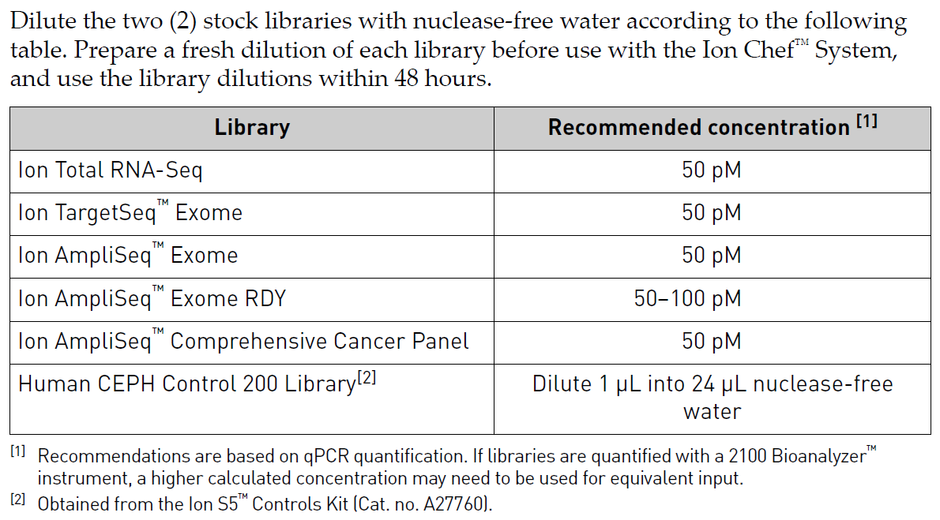
Diluting Libraries 540™ Chips

Slide 16
Setting up Ion Chef™

Slide 17
Fully Automated Template Preparation
2 samples
Ion Chef™
Template Prep
2 Loaded chips
Ion S5XL™ Sequencing
Data
Notes:
We will walk you through this training at a very high level first, and then dive into details

Slide 18
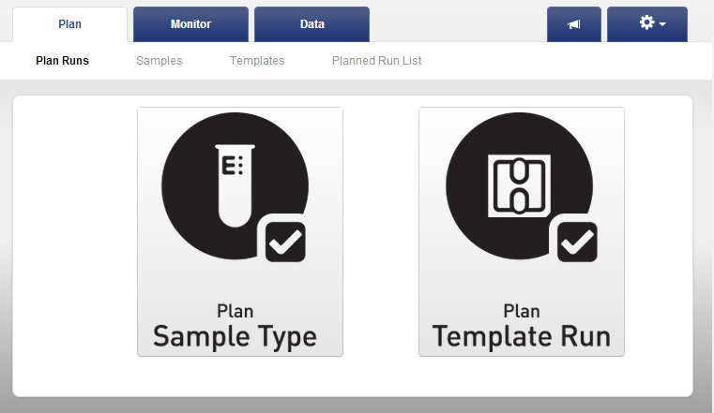
Fully Automated Template Preparation
2 samples
Ion Chef™
Template Prep
2 Loaded chips
Ion S5XL™ Sequencing
Data
Step 1
Plan run

Slide 19

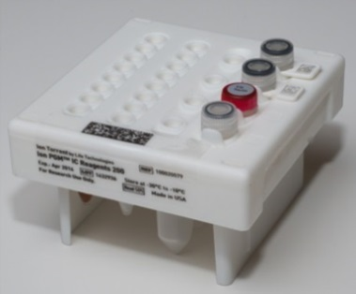
Fully Automated Template Preparation
2 samples
Ion Chef™
Template Prep
2 Loaded chips
Ion S5XL™ Sequencing
Data
Step 2
Load library samples into 4ºC Reagent Cartridge
Notes:
Each kit has 8 reactions. Each 4C reagent cartridges

Slide 20
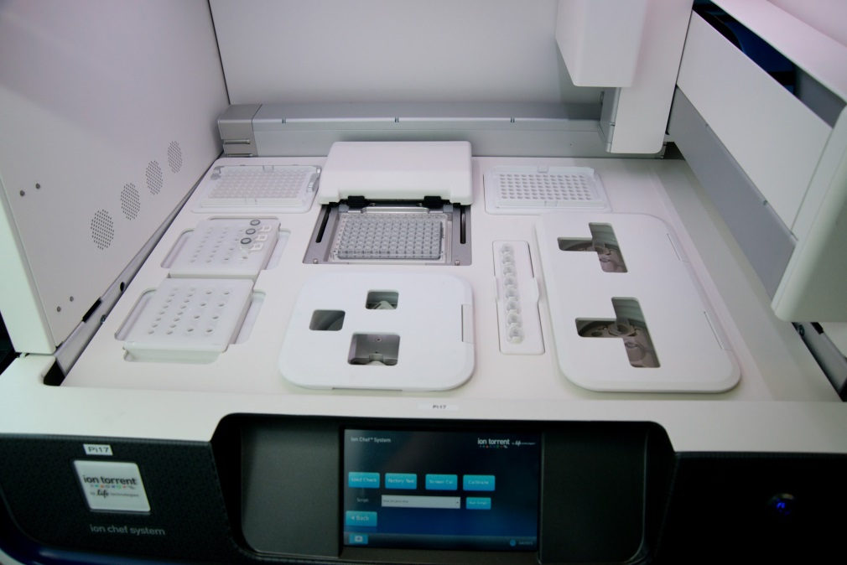

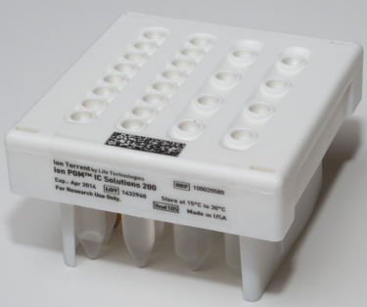
Fully Automated Template Preparation
2 samples
Ion Chef™
Template Prep
2 Loaded chips
Ion S5XL™ Sequencing
Data
Step 3
Load Reagent Cartridges
4º C Reagent
Cartridge
Ambient Temp
Reagent Cartridge
Notes:
Install both reagent cartridges

Slide 21
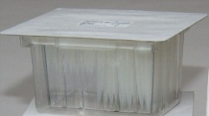
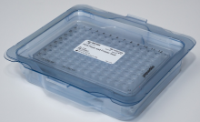
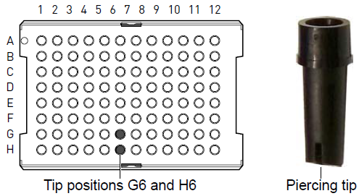
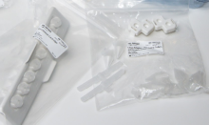
Fully Automated Template Preparation
2 samples
Ion Chef™
Template Prep
2 Loaded chips
Ion PGM ™ Sequencing
Data
Step 4
Load Plastic Consumables
Notes:
Add the tips and the empty tips rack in the back, add the plate and plate sealer in the middle. Add the enrichment tubes and recovery tubes

Slide 22
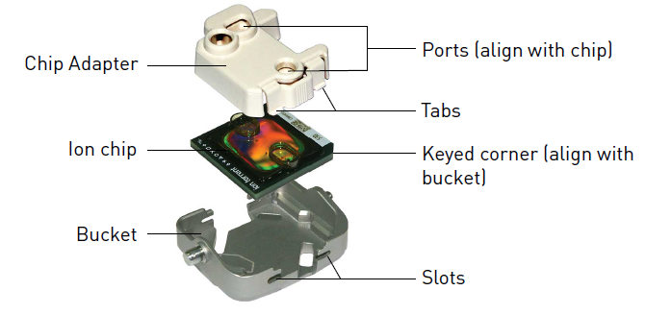
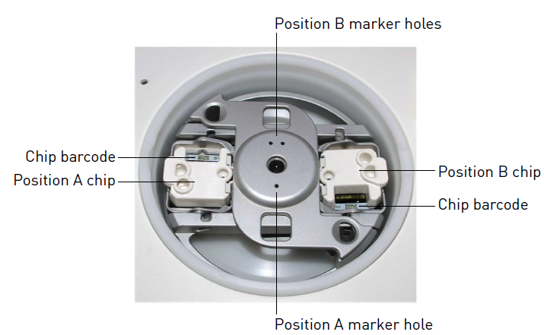
Fully Automated Template Preparation
2 samples
Ion Chef™
Template Prep
2 Loaded chips
Ion PGM ™ Sequencing
Data
Step 5
Attach adapters to chips, load chips
Notes:
Load both chips

Slide 23
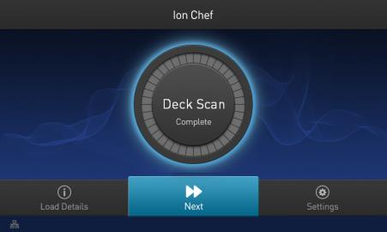
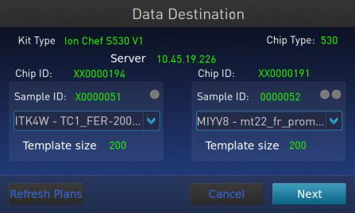
Fully Automated Template Preparation
2 samples
Ion Chef™
Template Prep
2 Loaded chips
Ion S5XL™ Sequencing
Data
Step 6
Start Run
When the deck is fully loaded, door closed and Desk Scan is complete, touch Next to display Data Destination
Confirm the instrument displays the correct kit name, chip types, and Planned Run. If the correct Planned Runs do not display, touch the drop-down menu to select the Planned Run for each chip, then touch Next.

Slide 24
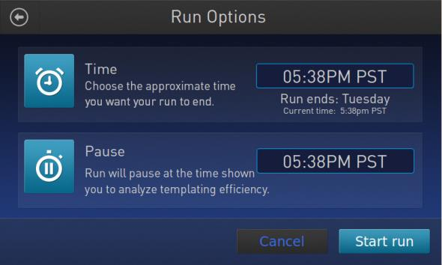
Run Options
The Ion Chef™ Instrument provides two options for obtaining quality control (QC) samples that can be used to assess templating efficiency.
Select Time or Pause and Start Run

Slide 25
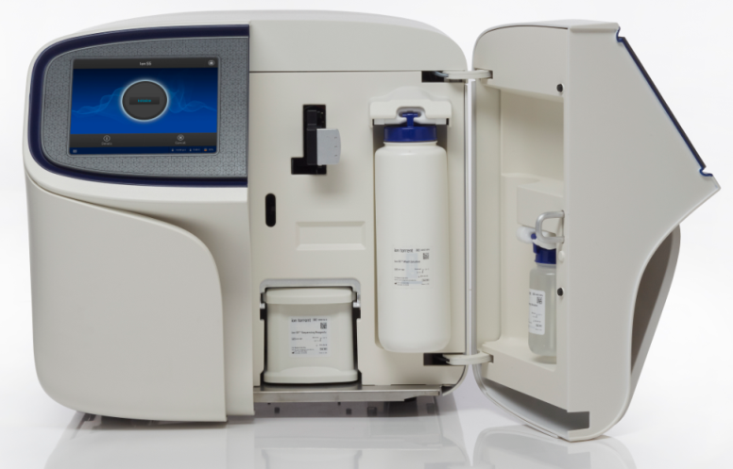
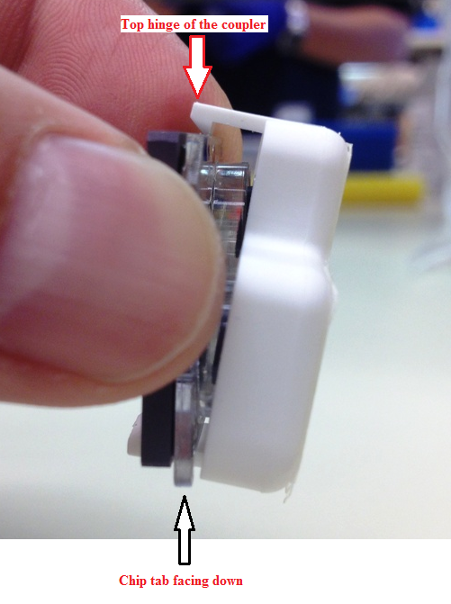

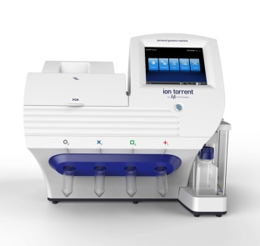
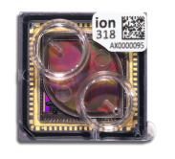

Fully Automated Template Preparation
2 samples
Ion Chef
Template Prep
2 Loaded chips
Ion S5XL™ Sequencing
Data
Ion Chef™
Ion PGM™
Sequencing
2 Samples in
2 Loaded
Chips
Data
Initialize
S5XL™
Start Sequencing Run
remove chips from Ion Chef
remove adapter
load chip onto S5XL™
Step 7
Step 8

Slide 26
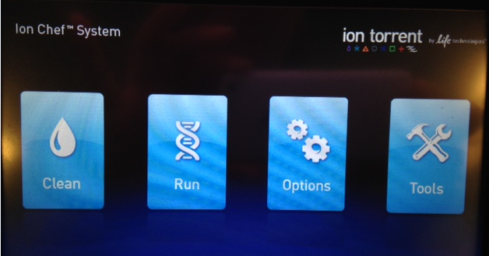
Fully Automated Template Preparation
2 samples
Ion Chef
Template Prep
2 Loaded chips
Ion PGM Sequencing
Data
Ion Chef™
Ion PGM™
2 Samples in
2 Loaded Chips
Sequencing
Data
Template Prep & Chip Loading
Step 9
Post-run clean
Location of waste
Press Clean button and follow instructions on screen
Note about liquid waste:
As there will be liquid waste in the used tip rack location, please take care not to spill on the deck. Volume of liquid waste: between 30-40mL. Do not over tilt the waste tip rack.

Slide 27
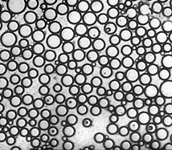
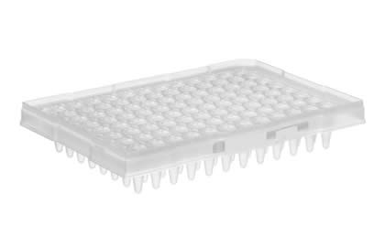
Steps automated by Ion ChefTM workflow
1) Aqueous prep:
2) PCR Amplification:
Aqueous Prep
HiQ™ equivalent
Emulsification
Tip mix to make drops
PCR Amplification
96-well thermal cycler
Notes:
Emulsion PCR: Oil and Amp reaction are mixed to generate microscopic reaction vesicles.
2) Amplification:
Vesicles enter amplification plate, and undergoes PCR
Breaking: Vesicles from amp plate are transferred into centrifuges, where they are injected into breaking centrifuges for purification. ISPs are recovered through centripetal force
4) Enrichment:
Biotinylated ISPs are enriched using separation with magnetic streptavidin beads.
5) Sequencing biochem: sequencing primer is annealed to DNA on ISPs and polymerase is added
4) Chip Loading: Chips are loaded for PGM sequencing run

Slide 28
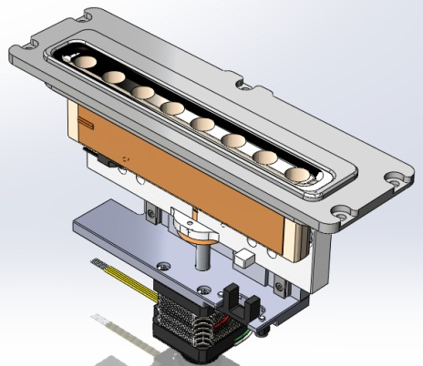
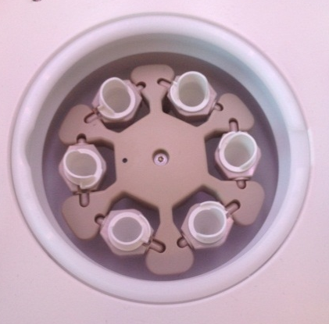
Steps automated by Ion ChefTM workflow
3) Recovery:
4) Enrichment:
Recovery
Bulk Breaking –oil removed
Clean up similar to manual process
Enrichment
Notes:
Emulsion PCR: Oil and Amp reaction are mixed to generate microscopic reaction vesicles.
2) Amplification:
Vesicles enter amplification plate, and undergoes PCR
Breaking: Vesicles from amp plate are transferred into centrifuges, where they are injected into breaking centrifuges for purification. ISPs are recovered through centripetal force
4) Enrichment:
Biotinylated ISPs are enriched using separation with magnetic streptavidin beads.
5) Sequencing biochem: sequencing primer is annealed to DNA on ISPs and polymerase is added
4) Chip Loading: Chips are loaded for PGM sequencing run

Slide 29
Ion Chef™ Emulsion Breaking:
IPS are released from emulsion
vesicles via centrifugation through a layer of Recovery Solution. Oil and aqueous phase are removed by the robot during wash steps.
Emulsion
Recovery Solution
Oil
ISPs
Notes:
Workflow Summary
Breaking is carried out in the white breaking centrifuge tubes for each sample.
1: Partial fill with Recovery Solution
2: Emulsion layered on top
3. Centrifugation forces vescicles downward, release/pellet ISPs
Remove Oil + Aq; leave pellet
5. Add Recovery Solutio to Step1 vol.
Repeat Steps 2 through 4

Slide 30
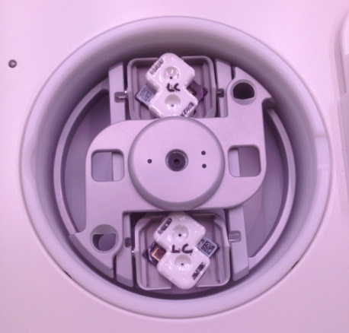
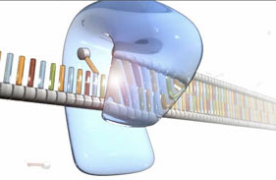
Steps automated by Ion ChefTM workflow
5.) Chip Loading
Loading
Primer annealing
Chip loading
Polymerase addition
S5™ sequencing-ready
Notes:
Emulsion PCR: Oil and Amp reaction are mixed to generate microscopic reaction vesicles.
2) Amplification:
Vesicles enter amplification plate, and undergoes PCR
Breaking: Vesicles from amp plate are transferred into centrifuges, where they are injected into breaking centrifuges for purification. ISPs are recovered through centripetal force
4) Enrichment:
Biotinylated ISPs are enriched using separation with magnetic streptavidin beads.
5) Sequencing biochem: sequencing primer is annealed to DNA on ISPs and polymerase is added
4) Chip Loading: Chips are loaded for PGM sequencing run

Slide 31
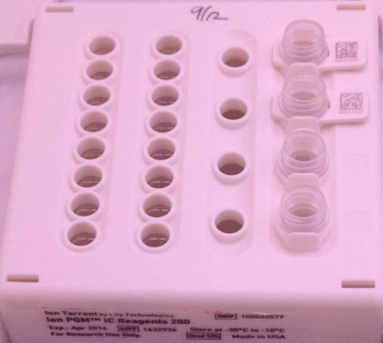
QC sample Locations:
Qubit Sample – Reagent Cartridge
Pre Enriched Sample Only
Sample 1
Sample 2

Slide 32
Sample / Reagent Tracking on Ion Chef™

Slide 33
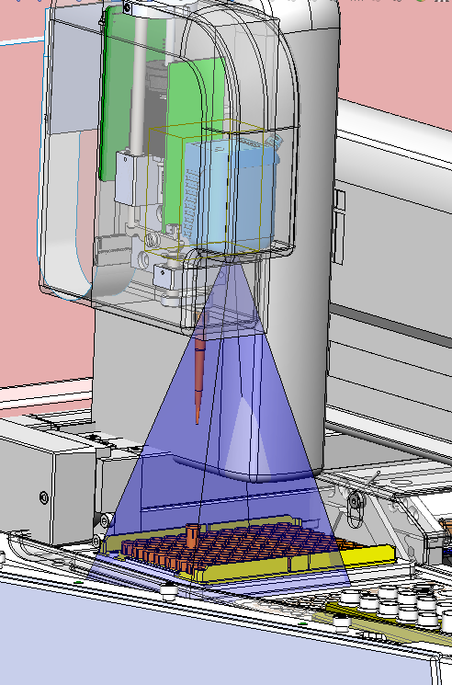
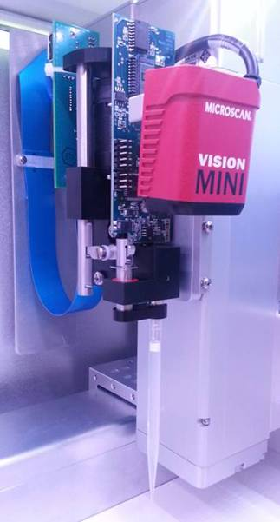
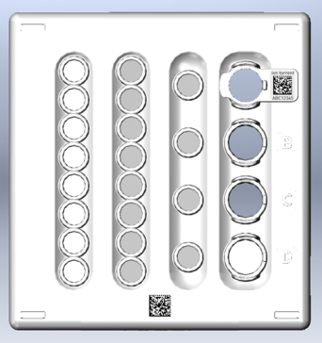
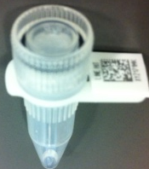

Sample / Reagent Tracking
Automated sample tracking and pre-run check:
Microscan Vision System (camera and barcode reader)
Sample tracking functionality
Barcoded chips, library samples
Setup check
Scans all stations to ensure setup done correctly
Scans during post-run clean as well
Notes:
Microscan Vision system for
Barcode reading – samples, chips, reagents
Automated calibration
Load check
Unload check

Slide 34


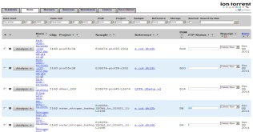
Ion Chef™ System enables
sample tracking and LIMS/ITS integration
Plan
Monitor
Data
Plan Ion ChefTM run
Execute Ion ChefTM run
Review PGMTM data
Scan library tube in reagent cartridge and associate with customer sample library
Vision system links the library barcode with the chip barcode
Data from S5™chip is linked to the library in the Data tab

Slide 35
S5/S5 XL System Overview

Slide 36
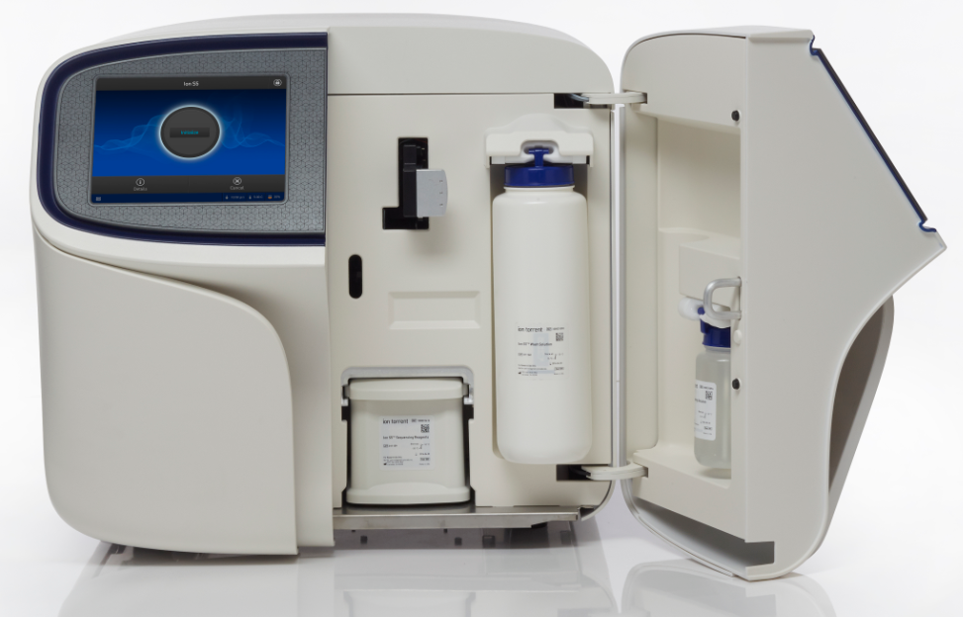
Plug and Play Reagents
Large HD Touchscreen
Temp Controlled Chip Clamp
Standard Power
Sequencing Reagent
Cartridge
Wash Solution
&
Waste Cartridge
(behind W2 Solution)
Automated
Cleaning Solution
Notes:
Large HD touchscreen – High quality
Temp control Chip Clamp – allows us to adjust temperature to optimize our chemistry
Automated cleaning solution – cleans after instrument run is complete
W2 solution – comes prefilled and pH-ed to optimal running condition. No need for high quality water
Waste cartridge – senses when waste is full and ask for your intervention to dump waste.
Sequencing cartridge – nucleotides are ready to go.
Finally- all you need is a 110 V plug outlet. We’ve removed the need for gas with our internal pump system and with our prefilled reagents high quality water is no longer a requirement.

Slide 37
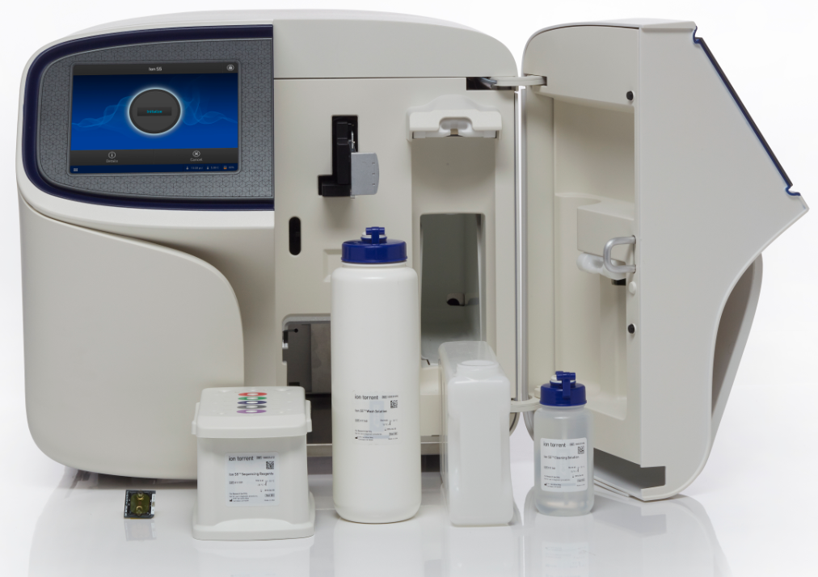
Single Use Consumables & Easy Tracking with RFID tags
RFID
tag
Tracking
Electronic Barcode
(1x use)
Reagent Cartridge
(1x use)
Wash
Solution
(1x use)
Waste Container
(Reusable)
Cleaning Solution
(4x use)
Universal kit for any chip type or read length
12 month Shelf-Life
Notes:
Efuse?

Slide 38
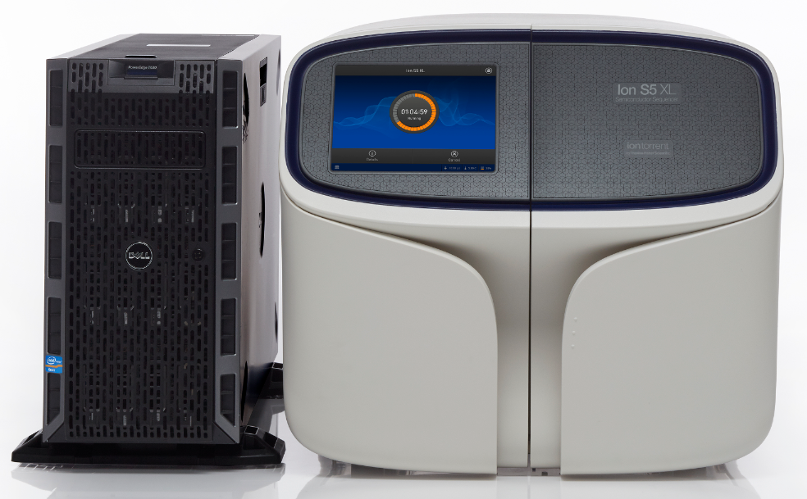

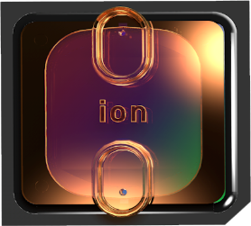

Ion S5™ XL System
Rapid sequencing and analysis for labs requiring more output or multiple runs per day
2.5 hr sequencing runs
Fast analysis. 1 hour – 5 hours, depending on chip type
Ion 520™
5 M Reads
Ion 530™
15-20 M Reads
Ion 540™
60-80 M Reads

Slide 39
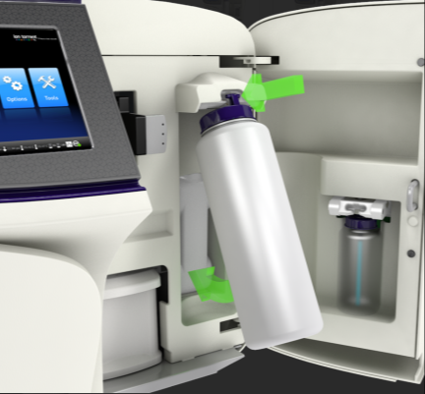
Easy and fast instrument setup
Install waste container, Wash Solution, Cleaning Solution and Nucleotide Cartridge
Install Chip
Select run plan, click Go!
Notes:
Comment that there’s no autoph initiate time.

Slide 40
Ion S5™/S5™ XL System Performance
 | 200bp Sequencing Time S5/S5 XL | 200bp Analysis Time* S5 XL | 200bp Analysis Time* S5 | Output | Reads | Read Length
Ion 520™ Chip | 2.5 hr | ~1 hr | ~5 hr | 1-2 Gb | 3-5 M | Up to 400bp
Ion 530™ Chip | 2.5 hr | ~2.5 hr | ~8 hr | 3-5 Gb | 15-20 M | Up to 400bp
Ion 540™ Chip | 2.5 hr | ~5 hr | ~16.5 hr | 10-15 Gb | 60-80 M | Up to 200bp
Analysis time to BAM file

Slide 41
Ion Chef System for Automated Library & Template Prep with Ion S5 Systems Up to 40 Libraries Per Week At Optimized Workflow
Mon
Tue
Wed
Thu
Fri
Workflow | Unit | Day | Night | Day | Night | Day | Night | Day | Night | Day | Totals
Library Prep | Samples | 8 | 8 | 8 |  | 8 |  | 8 |  |  | 40
Templating | Samples |  |  |  | 16 |  | 16 |  | 8 |  | 40
Sequencing | Chip |  |  |  |  | 2 |  | 2 |  | 1 | 5
Assumes an 8 hour work day (with overnight run), 5 day work week
1 Ion Chef System and 1 Ion S5 System

Slide 42
Plan and Execute a Run

Slide 43

Torrent Browser Intro (Live Demo Run Plan)
http://10.56.120.36/plan/

Slide 44

Torrent Browser Plan Creation
Ion PGM Hi-Q Chef Kit
Ion PGM Hi-Q Sequencing Kit
Notes:
Select Ion Chef no OneTouch, IC 200 kits, and v2 chips only.

Slide 45

Torrent Server Plan Creation
Scan or type sample tube barcode (included in kit)

Slide 46


Ion Torrent™ : Semiconductor Sequencing for Life™
Support
Robert David
6178723352
Robert.David@thermofisher
ionsupport@lifetech.com
Call 800-955-6288 in USA
Bioinformatics support
ngs-amsupport@lifetech.com
Jingwei.Ni@thermofisher.com
Online info for Ion Torrent Systems Thermofisher Ion Community
The Chip is the Machine™
Notes:
PLEASE CHANGE TECH SUPPORT NUMBER TO MATCH YOUR REGION’S CONTACT INFORMATION – THIS IS US-ONLY

Slide 47

For Research Use Only. Not for use in diagnostic procedures.
Ion Torrent™ is a Thermo Fisher Scientific brand. © 2014 Thermo Fisher Scientific, Inc. All rights reserved. TaqMan is a registered trademark of Roche Molecular Systems, Inc., used under permission and license. All other trademarks are the property of Thermo Fisher Scientific and its subsidiaries.

